Slide 1
ICS 240 Introduction to Data Structures
Jessica Maistrovich
Metropolitan State University

Slide 2
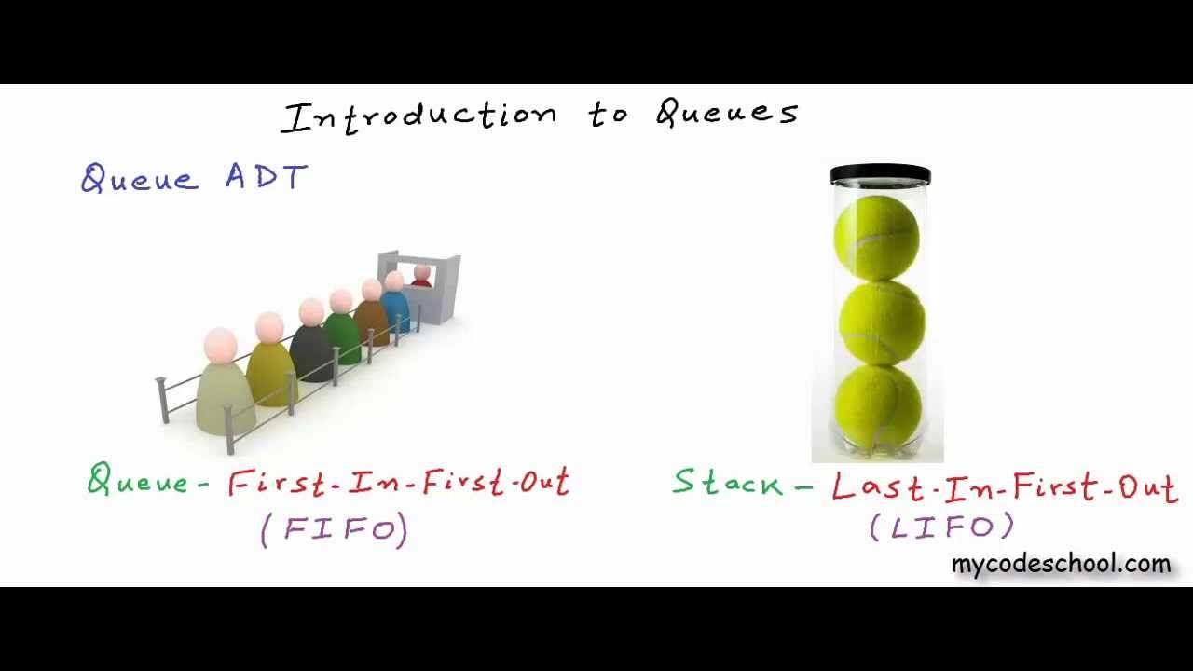
Queues vs. Stacks

Slide 3
Stack
Abstract Data Type

Slide 4
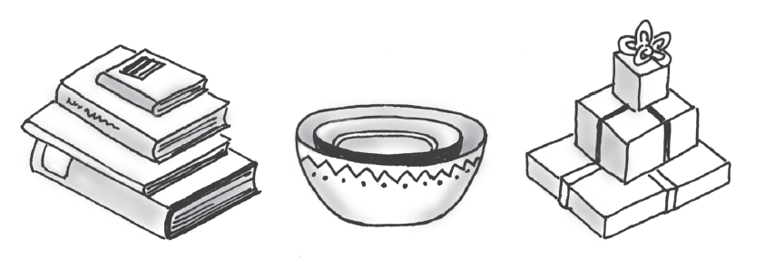
Example Stacks

Slide 5

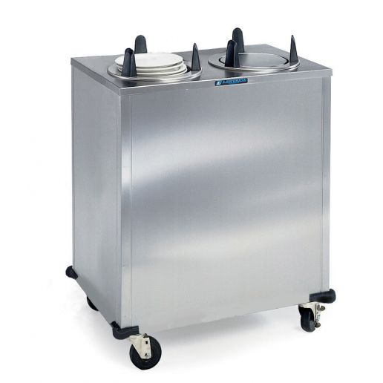

Slide 6
Introduction
A stack is a data structure of ordered items such that items can be inserted and removed only at one end (called the top).
A stack is called: Last-In-First-Out (LIFO) data structure
You can insert (or push) elements in the stack at any point of time.
You have access only to the element at the top of the stack (pop)
A stack can be implemented using either an array or a linked list

Slide 7
Stack Methods
Modifier and Type | Method and Description
boolean | isEmpty() Determine whether this stack is empty.
E | peek() Get the top item of this stack, without removing the item.
E | pop() Get the top item, removing it from this stack.
void | push(E item) Push a new item onto this stack.

Slide 8
Example of using Java’s Stack
What is the output of this code?
import java.util.Stack;
Stack<Integer> s = new Stack();
s.push(10);
s.push(20);
s.push(30);
s.pop();
s.push(40);
s.pop();
s.pop();
s.push(50);
while (!s.isEmpty()){
System.out.println(s.pop());
}
Notes:
50, 10

Slide 9
Example of using Java’s Stack
What is the output of this code?
import java.util.Stack;
Stack<Integer> s = new Stack();
s.push(10);
s.push(20);
s.push(30);
s.pop();
s.push(40);
s.pop();
s.pop();
s.push(50);
while (!s.isEmpty()){
System.out.println(s.pop());
}
top
Notes:
50, 10

Slide 10
Example of using Java’s Stack
What is the output of this code?
import java.util.Stack;
Stack<Integer> s = new Stack();
s.push(10);
s.push(20);
s.push(30);
s.pop();
s.push(40);
s.pop();
s.pop();
s.push(50);
while (!s.isEmpty()){
System.out.println(s.pop());
}
10
top
Notes:
50, 10

Slide 11
Example of using Java’s Stack
What is the output of this code?
import java.util.Stack;
Stack<Integer> s = new Stack();
s.push(10);
s.push(20);
s.push(30);
s.pop();
s.push(40);
s.pop();
s.pop();
s.push(50);
while (!s.isEmpty()){
System.out.println(s.pop());
}
20
10
top
Notes:
50, 10

Slide 12
Example of using Java’s Stack
What is the output of this code?
import java.util.Stack;
Stack<Integer> s = new Stack();
s.push(10);
s.push(20);
s.push(30);
s.pop();
s.push(40);
s.pop();
s.pop();
s.push(50);
while (!s.isEmpty()){
System.out.println(s.pop());
}
30
20
10
top
Notes:
50, 10

Slide 13
Example of using Java’s Stack
What is the output of this code?
import java.util.Stack;
Stack<Integer> s = new Stack();
s.push(10);
s.push(20);
s.push(30);
s.pop();
s.push(40);
s.pop();
s.pop();
s.push(50);
while (!s.isEmpty()){
System.out.println(s.pop());
}
30
20
10
top
Notes:
50, 10

Slide 14
Example of using Java’s Stack
What is the output of this code?
import java.util.Stack;
Stack<Integer> s = new Stack();
s.push(10);
s.push(20);
s.push(30);
s.pop();
s.push(40);
s.pop();
s.pop();
s.push(50);
while (!s.isEmpty()){
System.out.println(s.pop());
}
40
20
10
top
Notes:
50, 10

Slide 15
Example of using Java’s Stack
What is the output of this code?
import java.util.Stack;
Stack<Integer> s = new Stack();
s.push(10);
s.push(20);
s.push(30);
s.pop();
s.push(40);
s.pop();
s.pop();
s.push(50);
while (!s.isEmpty()){
System.out.println(s.pop());
}
40
20
10
top
Notes:
50, 10

Slide 16
Example of using Java’s Stack
What is the output of this code?
import java.util.Stack;
Stack<Integer> s = new Stack();
s.push(10);
s.push(20);
s.push(30);
s.pop();
s.push(40);
s.pop();
s.pop();
s.push(50);
while (!s.isEmpty()){
System.out.println(s.pop());
}
40
20
10
top
Notes:
50, 10

Slide 17
Example of using Java’s Stack
What is the output of this code?
import java.util.Stack;
Stack<Integer> s = new Stack();
s.push(10);
s.push(20);
s.push(30);
s.pop();
s.push(40);
s.pop();
s.pop();
s.push(50);
while (!s.isEmpty()){
System.out.println(s.pop());
}
40
50
10
top
Notes:
50, 10

Slide 18
Example of using Java’s Stack
What is the output of this code?
50
import java.util.Stack;
Stack<Integer> s = new Stack();
s.push(10);
s.push(20);
s.push(30);
s.pop();
s.push(40);
s.pop();
s.pop();
s.push(50);
while (!s.isEmpty()){
System.out.println(s.pop());
}
40
50
10
top
Notes:
50, 10

Slide 19
Example of using Java’s Stack
What is the output of this code?
50
10
import java.util.Stack;
Stack<Integer> s = new Stack();
s.push(10);
s.push(20);
s.push(30);
s.pop();
s.push(40);
s.pop();
s.pop();
s.push(50);
while (!s.isEmpty()){
System.out.println(s.pop());
}
40
50
10
top
Notes:
50, 10

Slide 20
Applications that Use a Stack
A web browser keeps a stack of recently visited web pages so that that you can use the back button.
A text editor uses a stack to handle the undo operation.
Function calls in any programming languages are handled by a stack

Slide 21
Array Implementation
How would you implement a stack with an array?

Slide 22
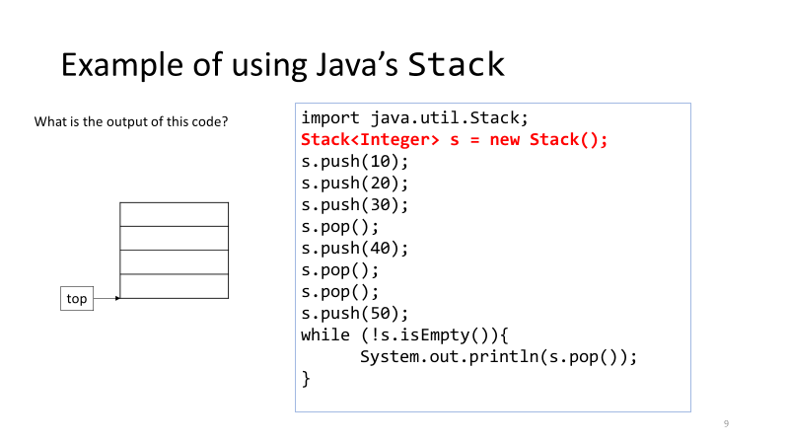

Slide 23
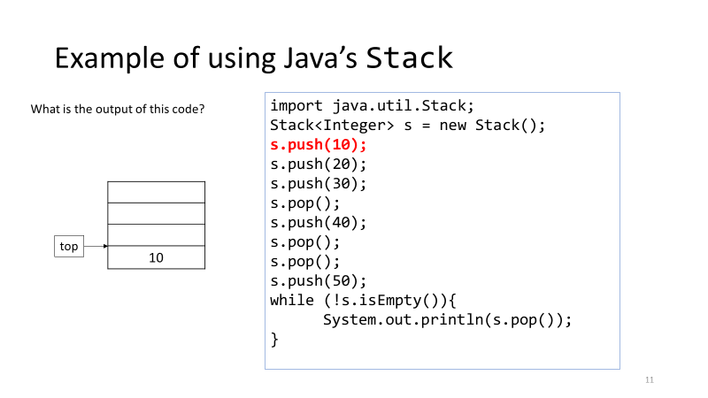

Slide 24
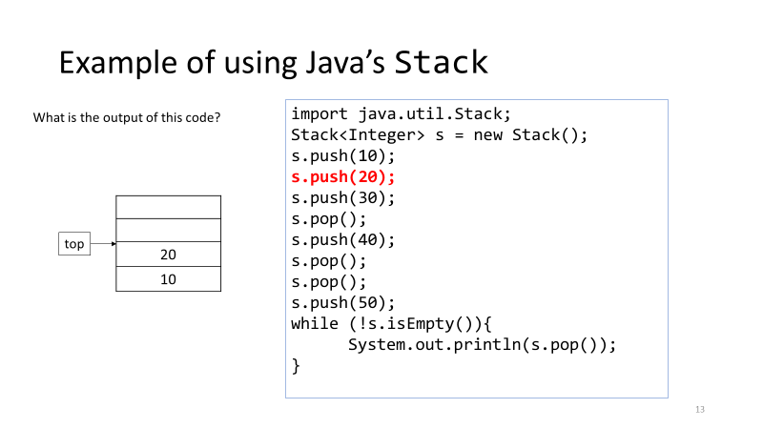

Slide 25
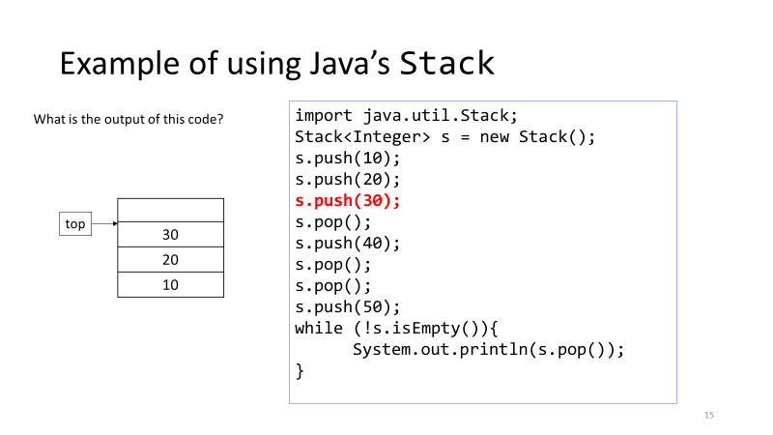

Slide 26
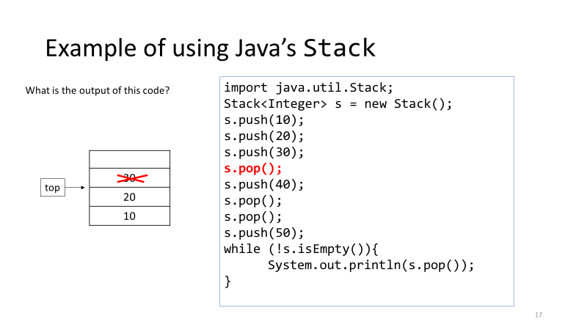

Slide 27
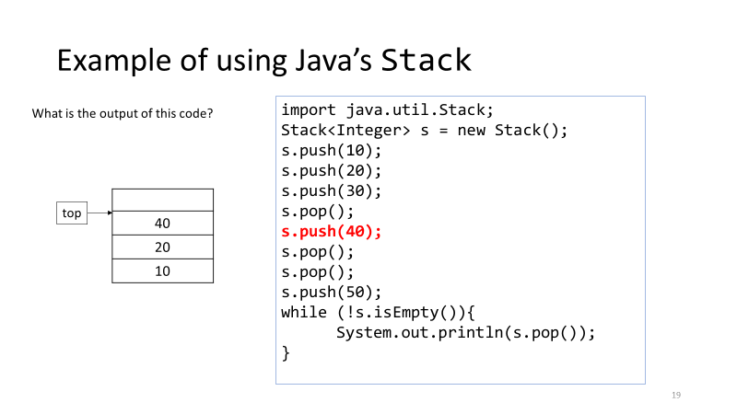

Slide 28
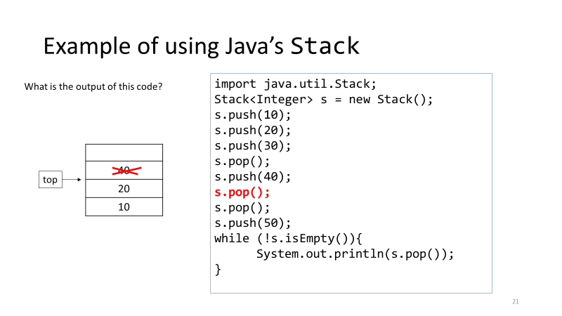

Slide 29
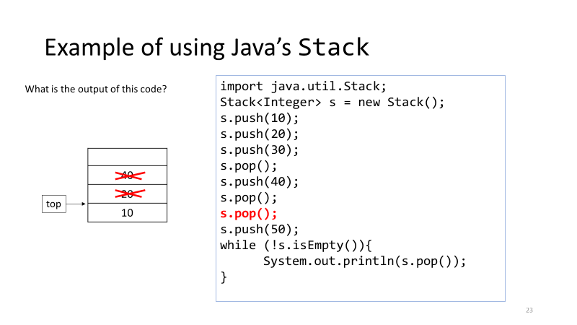

Slide 30
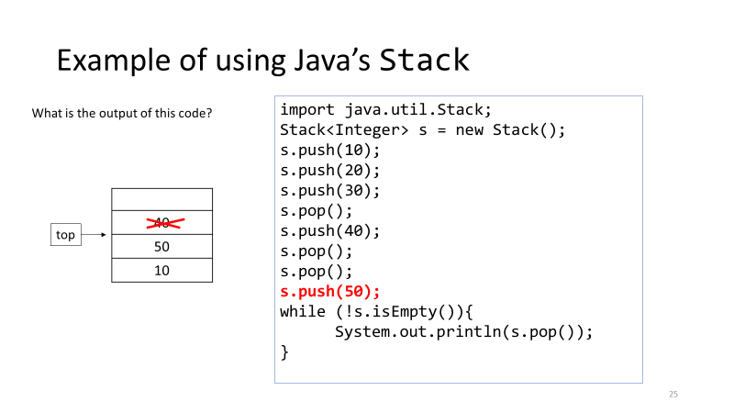

Slide 31
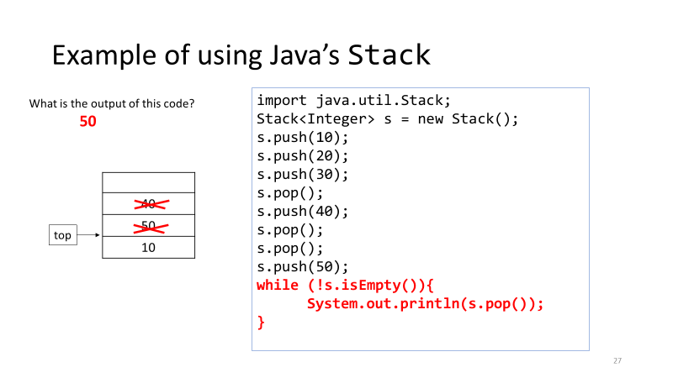

Slide 32
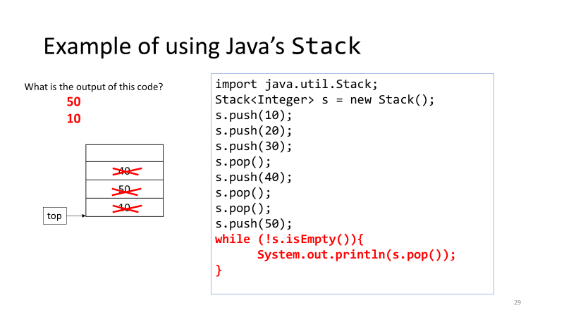

Slide 33
ArrayStack Class Diagram
ArrayStack<E>
-data:Object[] -top:int
+ArrayStack(int) +push(E):void +pop():E +peek():E +isEmpty():boolean

Slide 34
ArrayStack Invariant
/**
Invariant of the Stack that is implemented using an Array:
The number of items in the stack is stored in the instance variable top. 0 <= top <= capacity of data array
2. The items in the stack are stored in a partially filled array called data with the bottom of the stack at data[0], the next item is at data[1], and so on,
and the top of the stack at data[top-1]
*/

Slide 35
Adding or Deleting Elements
Add element to stack (push)
data[top++] = elementToAdd;
Remove element from stack (pop)
return data[--top];

Slide 36
Linked List Implementation
How would you implement a stack with a linked list?

Slide 37

Recall: Add at the Front of the Linked List
IntNode head;
head = new IntNode(35, head);
head = new IntNode (15, head);
head = new IntNode (10, head);

Slide 38
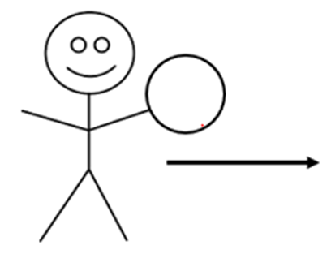
Add at the Front of the Linked List
IntNode head;
head = new IntNode(35, head);
head = new IntNode (15, head);
head = new IntNode (10, head);
35

Slide 39
Add at the Front of the Linked List
IntNode head;
head = new IntNode(35, head);
head = new IntNode (15, head);
head = new IntNode (10, head);
35

Slide 40

Add at the Front of the Linked List
IntNode head;
head = new IntNode(35, head);
head = new IntNode (15, head);
head = new IntNode (10, head);
15
35

Slide 41
Add at the Front of the Linked List
IntNode head;
head = new IntNode(35, head);
head = new IntNode (15, head);
head = new IntNode (10, head);
15
35

Slide 42
Add at the Front of the Linked List
IntNode head;
head = new IntNode(35, head);
head = new IntNode (15, head);
head = new IntNode (10, head);
10
15
35

Slide 43
Add at the Front of the Linked List
IntNode head;
head = new IntNode(35, head);
head = new IntNode (15, head);
head = new IntNode (10, head);
10
15
35

Slide 44
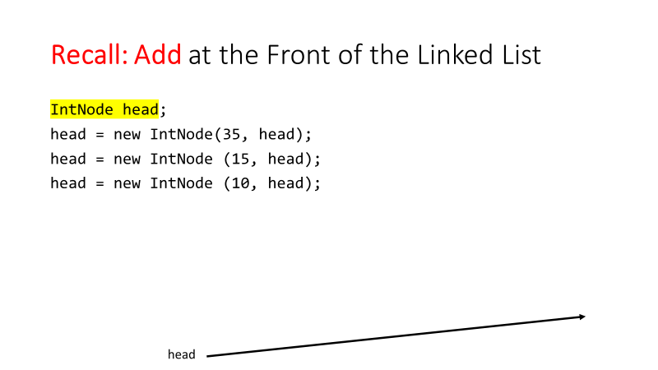

Slide 45
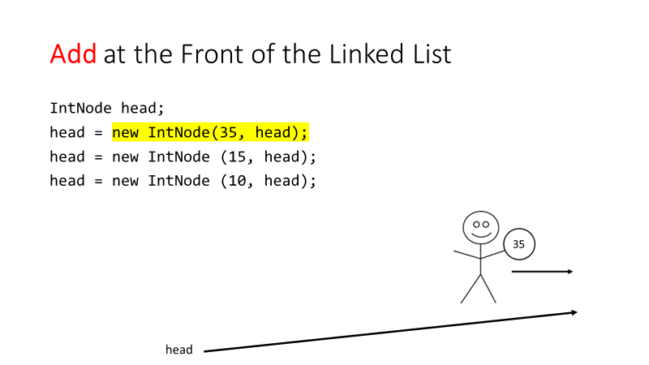

Slide 46
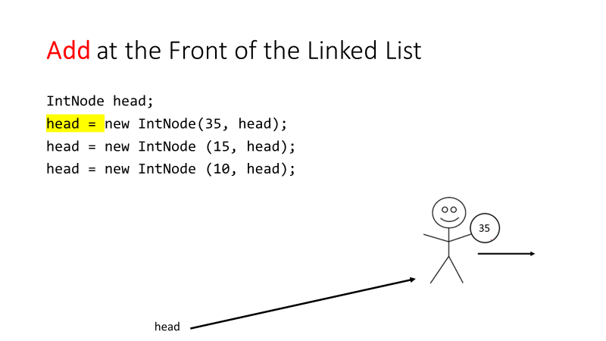

Slide 47
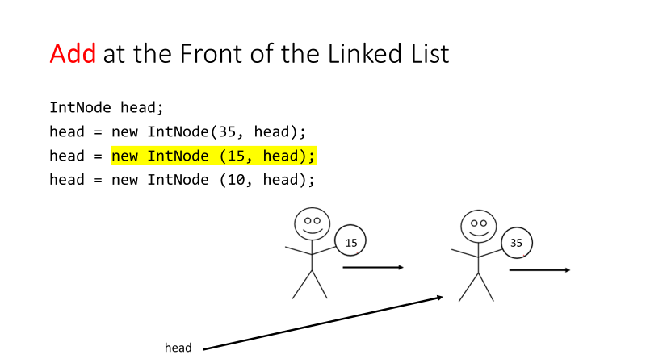

Slide 48
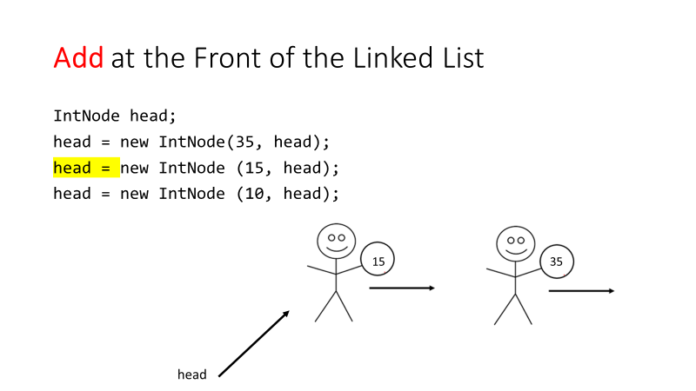

Slide 49
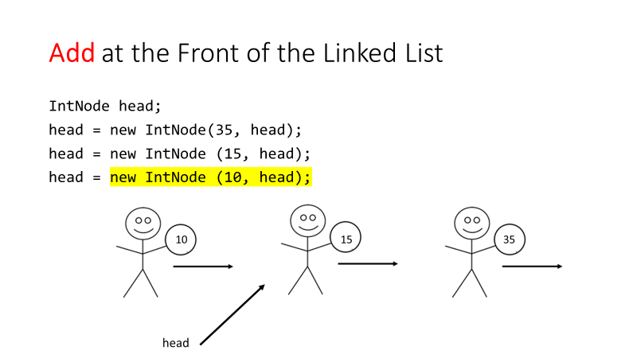

Slide 50
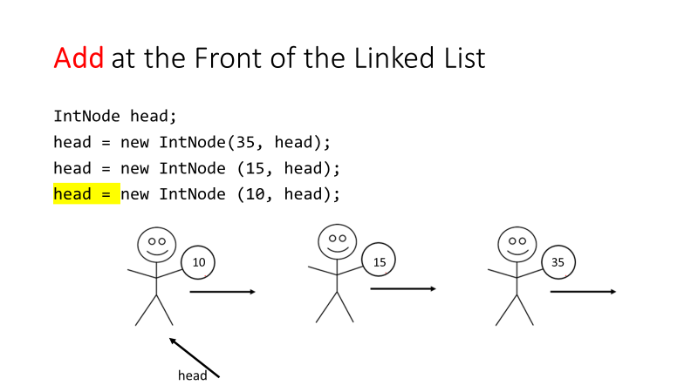

Slide 51
Instead of using head, use top
top

Slide 52
top

Slide 53
top

Slide 54
top

Slide 55
top

Slide 56
top

Slide 57
top

Slide 58
top

Slide 59
top

Slide 60
top

Slide 61
top

Slide 62
LinkStack Class Diagram
LinkStack<E>
-top:Node<E> -manyNodes:int
+LinkStack() +push(E):void +pop():E +peek():E +isEmpty():boolean

Slide 63
LinkStack Invariant
/**
Invariant:
1. The items in the stack are stored in a linked list, with the top of the stack stored at the head node, down to the bottom of the stack at the final node.
2. The instance variable top is the head reference of the linked list of items.
3. The instance variable manyNodes indicates the size of the Stack
*/

Slide 64
Adding or Deleting Elements
Add element to stack (push)
top = new Node<E>(E elementToAdd, top);
manyNodes++;
Remove element from stack (pop)
E element = top.getData();
top = top.getLink();
manyNodes--;
return element;

Slide 65
Try it!
Create a generic stack class. Test it with a driver.

Slide 66
Queue
Abstract Data Type

Slide 67


Examples of Queues

Slide 68
What is a Queue?
A queue is a data structure of ordered items such that items can be inserted at one end (called tail) and removed only at the other end (called head)
The defining property of a queue data structure is First-In-First-Out (FIFO)
You can add (or enqueue) elements in the queue at any point of time
You can remove/read only the element at the front of the queue (dequeue)
A queue can be implemented using either an array or a linked list

Slide 69
Queue Methods
Modifier and Type | Method and Description
boolean | isEmpty() Determine whether this queue is empty.
E | peek() Get the front item of this queue, without removing the item.
E | dequeue() Get the front item, removing it from this queue.
void | enqueue(E item) Put a new item into the rear of this queue.

Slide 70
Applications that Use a Queue
A printer keeps a queue of documents to be printed
A queue is used in simulations to simulate:
Cars waiting in traffic lines
Customers waiting in a bank or cashier queues
Internet traffic

Slide 71
Linked List Implementation
How would you implement a queue with a linked list?

Slide 72
Recall: Add at the Front of the Linked List
head = new Node<E> (E elementToAdd, head);
15
35

Slide 73
Recall: Add at the Front of the Linked List
head = new Node<Integer> (10, head);
10
15
35

Slide 74
Recall: Remove from the Front of the Linked List
head = head.getLink();
10
15
35

Slide 75
Recall: Remove from the Front of the Linked List
head = head.getLink()
15
35

Slide 76
What if we could access both ends?
Keep track of tail
10
15
35
tail

Slide 77
Add to tail
tail.setLink(new Node<E>(E elementToAdd, null));
tail = tail.getLink();
10
15
35
tail

Slide 78
Add to tail
5
tail.setLink(new Node<Integer>(5, null));
tail = tail.getLink();
10
15
35
tail

Slide 79
Add to tail
5
tail.setLink(new Node<Integer>(5, null));
tail = tail.getLink();
10
15
35
tail

Slide 80
Add to tail
5
tail.setLink(new Node<Integer>(5, null));
tail = tail.getLink();
10
15
35
tail

Slide 81
Remove from tail
5
tail = findPrevious();
10
15
35
tail

Slide 82
Remove from tail
5
tail = findPrevious();
10
15
35
tail

Slide 83
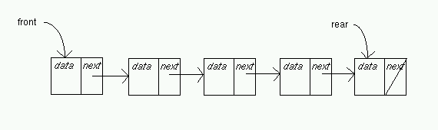
LinkQueue Implementation
public class LinkQueue<E> {
private int manyNodes;
private Node<E> head;
private Node<E> tail;
}
Keep two pointers, head and tail, to the first and last elements in the queue respectively.
How to perform enqueue() and dequeue()?
Case 1: add at tail, remove at head:
Insert O(1)
Delete O(1)
Case 2: add at head, remove at tail: ➔ not used in practice – listed here just for comparison purposes
Insert O(1)
Delete O(n) ==> why?

Slide 84
Danger!!!
What about the border cases?
Adding to empty queue
Removing last element in the queue

Slide 85
Add to empty queue
head = new IntNode(35, head);
tail

Slide 86
Add to empty queue
head = new IntNode(35, head);
35
tail

Slide 87
Add to empty queue
head = new IntNode(35, head);
35
tail

Slide 88

Add to empty queue
head = new IntNode(35, head);
35
tail

Slide 89
enqueue()
public void enqueue(E item) {
if (manyNodes == 0){ {
head = new Node<E>(item, null);
tail = head;
} else {
tail.setLink(new Node<E>(item, null));
tail = tail.getLink();
}
manyNodes++;
}

Slide 90
Remove last element from queue
head = head.getLink();
35
tail

Slide 91
Remove last element from queue
head = head.getLink();
35
tail

Slide 92
dequeue()
public E dequeue() {
E element = head.getData();
head = head.getLink();
manyNodes--;
if (manyNodes==0){
tail = null;
}
return element;
}

Slide 93
LinkQueue Class Diagram
LinkQueue<E>
-head:Node<E> -tail:Node<E> -manyNodes:int
+LinkQueue() +enqueue(E):void +dequeue():E +peek():E +isEmpty():boolean

Slide 94
Invariant for LinkQueue
/** Invariant of the LinkQueue class:
* 1. The number of items in the queue is stored in the instance variable
* manyNodes
* 2. The items in the queue are stored in a linked list. The front of the
* queue is at the head of the list and is referenced by instance
* variable head. The instance variable tail points to the end of
* the queue and references the most recently added item.
* 3. For an empty queue, both head and tail are null.
*/

Slide 95
Array Implementation
How would you implement a queue with an array?

Slide 96
Challenges in ArrayQueue Implementation
How to maintain head and manyItems?
Solution 1:
Make head always at position 0 of the array
Always insert at manyItems position → insert is constant time O(1)
When an item is removed (i.e., data[0] is removed):
move all the remaining items up to fill the empty slot at position 0 → delete is linear time O(n)
Solution 2: Use a circular array
Goal is to avoid the O(n) cost of deletion
When using a circular array, then both insertion and deletion will be O(1)
Be careful about where the queue elements are stored in the array
Notes:
Discussion in class and in the text book pages 384 and 385

Slide 97
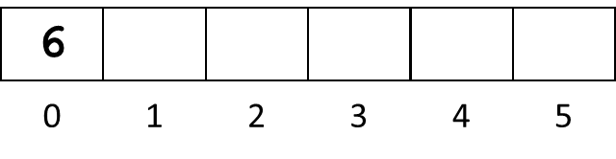
Array implementation
head = 0
manyItems = 1
What spot would we fill in next?

Slide 98
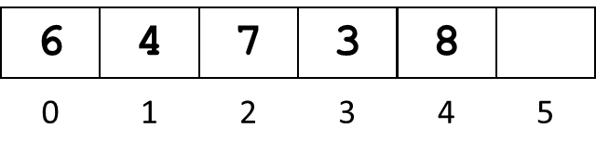
Array implementation
head = 0
manyItems = 5
What spot would we fill in next?

Slide 99
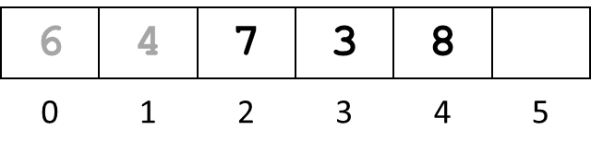
Array implementation
head = 2
manyItems = 3
What spot would we fill in next?

Slide 100
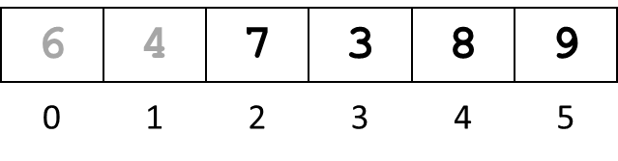
Array implementation
head = 2
manyItems = 4
What spot would we fill in next?

Slide 101
Array implementation
5
4
7
3
8
9
0
1
2
3
4
5
head = 2
manyItems = 5
What spot would we fill in next?

Slide 102
Circular Arrays
Use a circular array to insert and remove items from a queue in constant time
The idea of a circular array is that the end of the array “wraps around” to the start of the array
7
0
6
1
5
2
4
3

Slide 103
Array implementation
(head + manyItems) % array.length
(0 + 1) % 6 = 1
head = 0
manyItems = 1
What spot would we fill in next? 1

Slide 104
Array implementation
(head + manyItems) % array.length
(0 + 5) % 6 = 5
head = 0
manyItems = 5
What spot would we fill in next? 5

Slide 105
Array implementation
(head + manyItems) % array.length
(2 + 3) % 6 = 5
head = 2
manyItems = 3
What spot would we fill in next? 5

Slide 106
Array implementation
(head + manyItems) % array.length
(2 + 4) % 6 = 0
head = 2
manyItems = 4
What spot would we fill in next? 0

Slide 107
Array implementation
5
4
7
3
8
9
0
1
2
3
4
5
(head + manyItems) % array.length
(2 + 5) % 6 = 1
head = 2
manyItems = 5
What spot would we fill in next? 1

Slide 108
Adding or Deleting Elements
Add element to queue (enqueue)
data[(head + manyItems) % data.length] = elementToAdd;
manyItems++;
Remove element from queue (dequeue)
E temp = (E) data[head];
head = (head + 1) % data.length;
manyItems--;
return temp;

Slide 109
ArrayQueue Class Diagram
ArrayQueue<E>
-data:Object[] -head:int -manyItems:int
+ArrayQueue(int) +enqueue(E):void +dequeue():E +peek():E +isEmpty():boolean

Slide 110
ArrayQueue Invariant
/** Invariant of the ArrayQueue class:
* 1. The number of items in the queue is stored in the instance
* variable manyItems. 0 <= manyItems <= data.length
* 2. For a non-empty queue, the items are stored in a circular array
* beginning at data[head] and continuing through
* data[(head + manyItems) % data.length]
* 3. For an empty queue, manyItems is zero and data is a reference to
* an array, but we do not care about head position
*/

Slide 111
Try it!
Create a generic queue class. Test it with a driver.

